Slide 1

FINAL PROJECT REVIEW

Slide 2
THOUGHT TUNES - A SMART MUSIC PLAYER INVOLVING MIND-STATE AWARENESS
PROJECT REVIEW – 1st
GUIDE:
Ms.J.JULIE M.E,
Assistant Professor,
Department of IT
BATCHMATES:
SULTHAN I(412516205091)
SAHAYA NEBESON S(412516205072)

Slide 3
PREFACE
Abstract
Problem Statement
Literature Survey
Domain
Need & Objective
Existing Work & Demerits
Proposed Work & Merits
Complexity
Module Description
Output Snapshots
Future Work

Slide 4
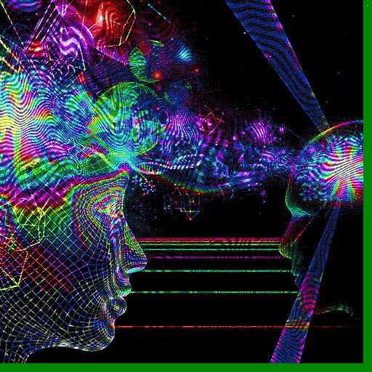
ABSTRACT
A Brain Computer Interface (BCI) is a new communication channel allows a person to control special computer applications through the use of his/her thoughts. BCI research is based on recording and analysing electroencephalographic (EEG) data and recognizing EEG patterns associated with various mental states.
A recurrent neural network involves processing nodes that has its own small sphere of knowledge, including what it has seen and any rules it was originally programmed with. It saves the output of processing nodes and feed the result back into the model. They are notable for being adaptive.
A key to connect the mind - music synchronization. Usage of mind-control devices for a broader range of applications other than medical equipment's, gaming, PC’s etc. Effective use of audio streaming by incorporating Neural network concepts.
To train and implement a smart music player which supports the listener by enhancing relaxation and mood conversions.
To provoke automation of playlist generation by means of analyzing the inputs obtained. To reduce overlap in mood extractions, maintain log of user preferences and save results of music experience.

Slide 5
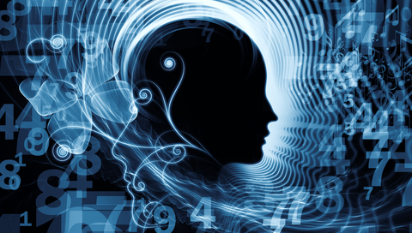
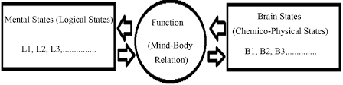

DRIVE
Music Therapy
Mind-Brain Identity Theory
It asserts that mental states can be grouped into types and can be correlated with types of physical events in the brain.
This is also referred as “Type Physicalism”

Slide 6

PROBLEM STATEMENT
Launching an automated platform that fetches the user’s state of mind in ease.
Scheme which emotes and evolves the user’s mood for betterment by providing class of music.
Application that generates customized
playlist.

Slide 7


Slide 8
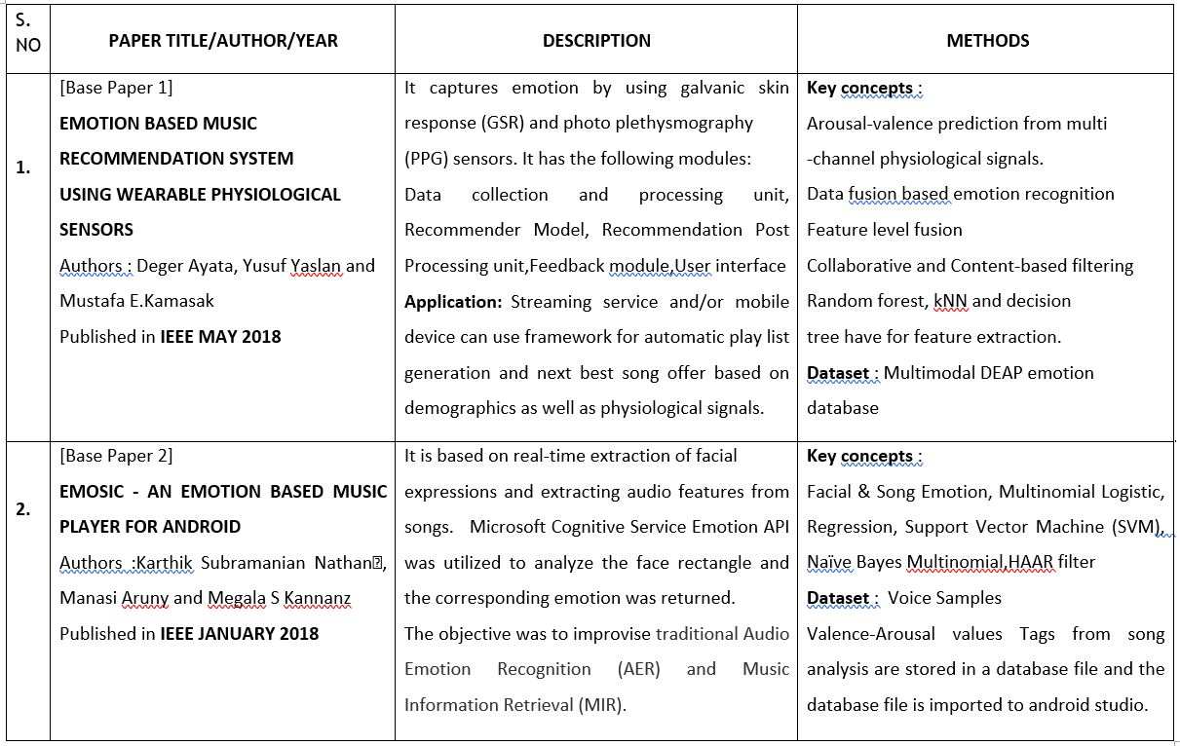

Slide 9
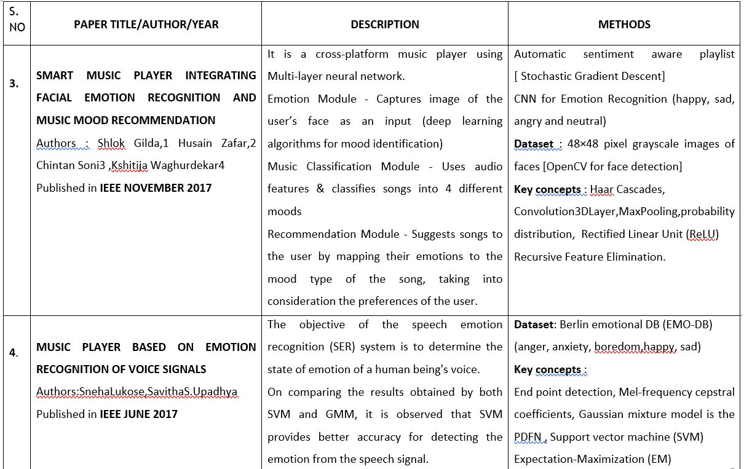

Slide 10
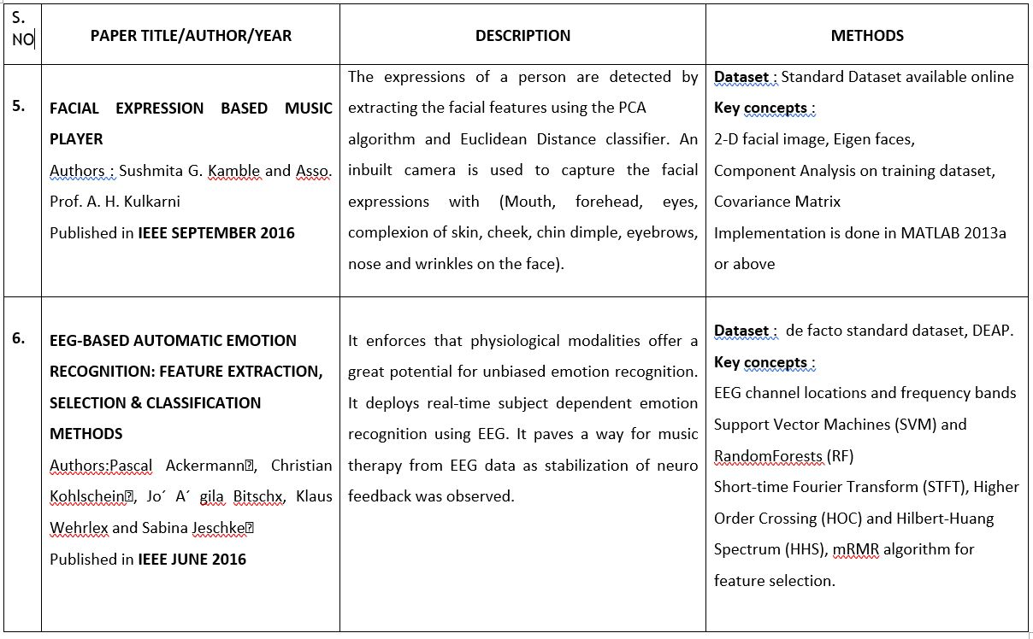

Slide 11
EXISTING SYSTEM
This work presents an idea to reform the existing access control system of detecting medical conditions related to brain and getting timely response from doctors in case of a medical emergency and hence this paper ensures that people can get good quality of healthcare facilities from doctors worldwide.
Using brain waves one can detect the abnormal behavior of brain and these waves are recorded using EEG electrodes and the obtained artifacts can be analyzed to predict the mental wellness of the patient.
These artifacts can be uploaded to cloud hub for easy access from all over the world.

Slide 12
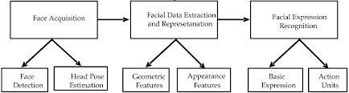
EXISTING WORK & DEMERITS
System does not support
automatic playlist generation.
It has to be created manually.
Camera quality must be high.
The current music players are linking the facial expressions and speech tones to recognize the mood of the listener to suggest rhythms.
Feature Extraction complexity is high and low accuracy.
It doesn’t contain a log of preferences(random probability)
Multiple outputs such as image and voice must be combined to extract the emotion of the user.
Not user-friendly.

Slide 13
PROPOSED SYSTEM:
Electroencephalography (EEG) which is an electrophysiological monitoring method to record electrical activity of the brain. The electrical signals are converted into digital format using EEG data collection. These data are then received by the wifi.
The wifi is connected to the firebase server. The app collects the information received via wifi and makes an emotion recognition which is done using feature extraction algorithm.
This provides an alpha/beta ratio of the analyzed data received from Bluetooth .
This is then converted into 3D model using VAD (Valence, Arousal, Dominance) identification.
The dimensional model is the most commonly used model for the classification of emotion because all discrete emotions can be represented in dimensional model by proposing that each discrete emotion represent the combination of several dimensions.

Slide 14
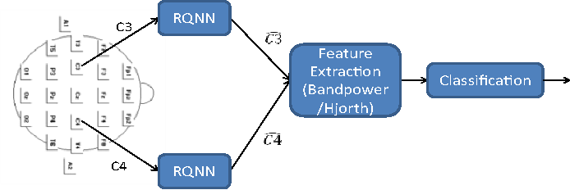
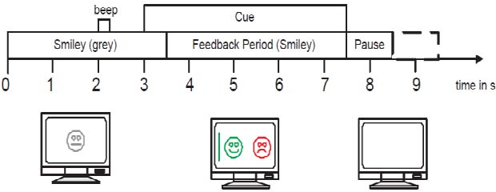
NEURAL NETWORKS IN BCI
A Brain Computer Interface (BCI) is a new communication channel allows a person to control special computer applications through the use of his/her thoughts. BCI research is based on recording and analyzing electroencephalographic (EEG) data and recognizing EEG patterns associated with various mental states.
A recurrent neural network involves processing nodes that has its own small sphere of knowledge, including what it has seen and any rules it was originally programmed with. It saves the output of processing nodes and feed the result back into the model. They are notable for being adaptive.

Slide 15
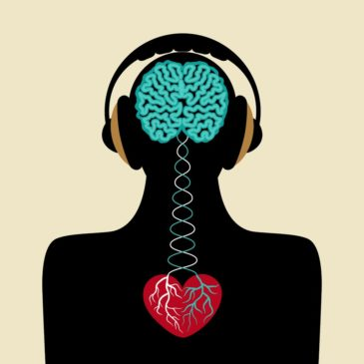
NEED
A key to connect the mind - music synchronization. Usage of mind-control devices for a broader range of applications other than medical equipment's, gaming, PC’s etc.
Effective use of audio streaming by incorporating Neural network concepts.
OBJECTIVE
To train and implement a smart music player which supports the listener by enhancing relaxation and mood conversions.
To provoke automation of playlist generation by means of analyzing the inputs obtained. To reduce overlap in mood extractions, maintain log of user preferences and save results of music experience.

Slide 16
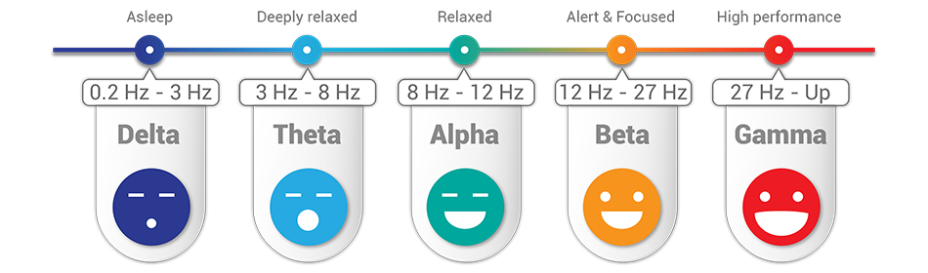

BRAINWAVE CLASSIFICATION
In human brain different frequency changes are observable in the spectrum of measured electric signals. The frequency components of these signals that occur as a consequence of electric impulse alternations can be measured by the EEG (electroencephalograph) device.

Slide 17
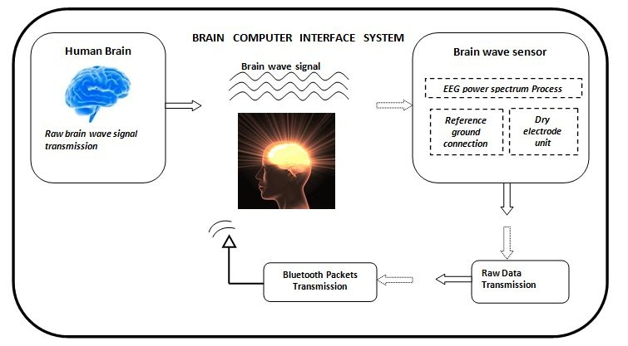
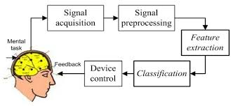
EXISTING SYSTEMS
Hardware Process
Software Analysis

Slide 18
PROPOSED WORK & MERITS
System supports automatic playlist generation.
Trained to produce optimum result
Camera is not needed.
The system incorporates a mind-wave capturing device that obtains the user’s emotional state.
This application provides the generation of customized playlist in accordance to the result of the analysis.
Music tracks are segregated by various levels of mental state in order to avoid overlapping between mood swings.
The key aspect of the system is to automate audio streaming and relish the user experience by contributing exact essence of music at the appropriate state of mind.
Feature Extraction complexity is minimum.
Mapping between mind state and physical state
It contains a log of preferences
Trendy and simple application with numerous benefits
Highly user-friendly and consists of heterogeneous tracks.

Slide 19
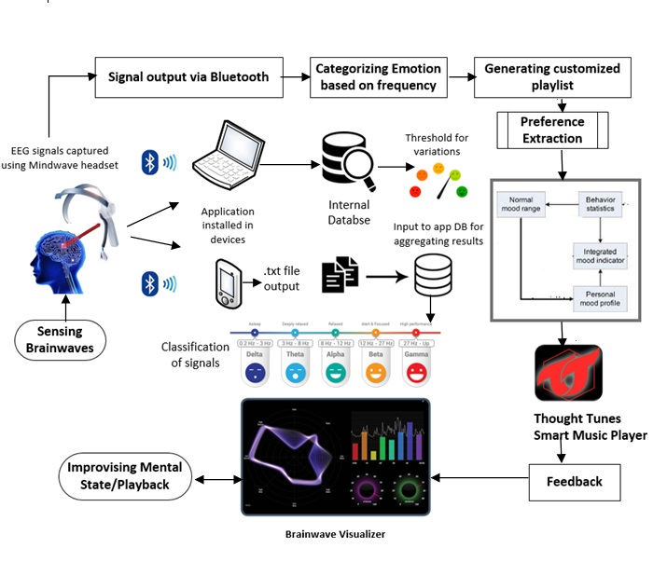

Slide 20





MODULE DESCRIPTION
1.Sensing Brainwaves
2. Developing Smart music player
3. Interfacing headset with Firebase
4.Analysing and playing music
20

Slide 21
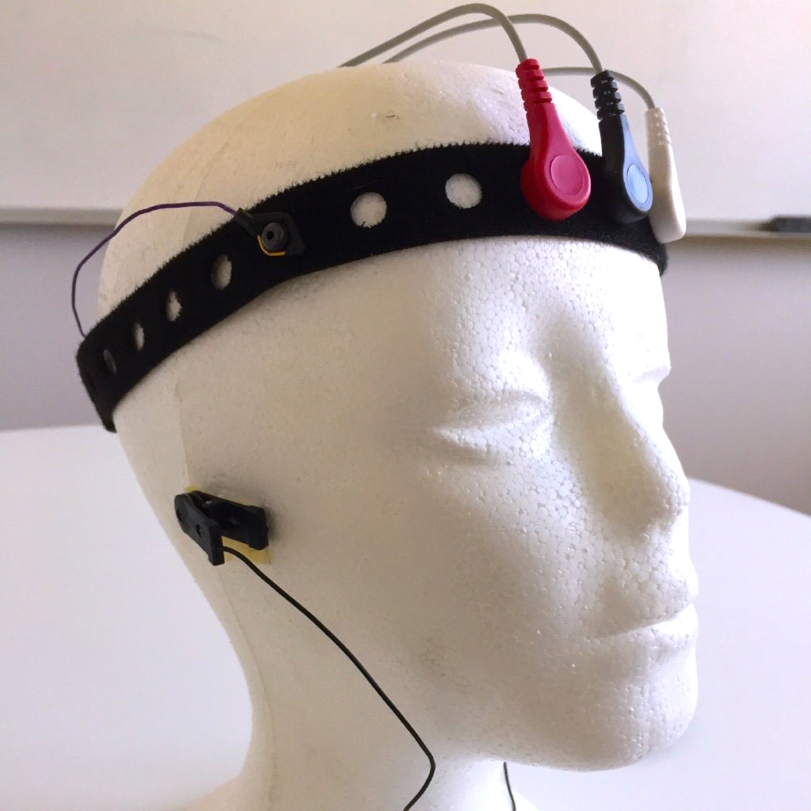
MODULE 1:
SENSING BRAINWAVES:
Electroencephalography (EEG) is an
electrophysiological monitoring method to
record electrical activity of the brain.
It is typically noninvasive, with the electrodes
placed along the scalp, although invasive
electrodes are sometimes used, as in
electrocorticography
21

Slide 22
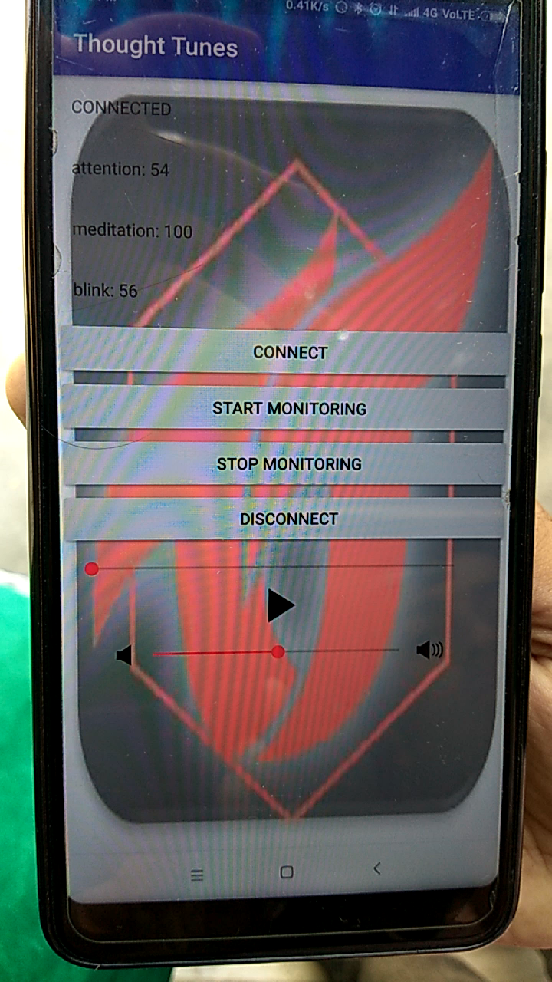
MODULE 2:
SMART MUSIC PLAYER
Music Player lets you manage all
your music files quickly and easily .
This audio player supports almost
all types of mp3 , midi ,wav ,
flac raw aac files and other audio
formats
22

Slide 23
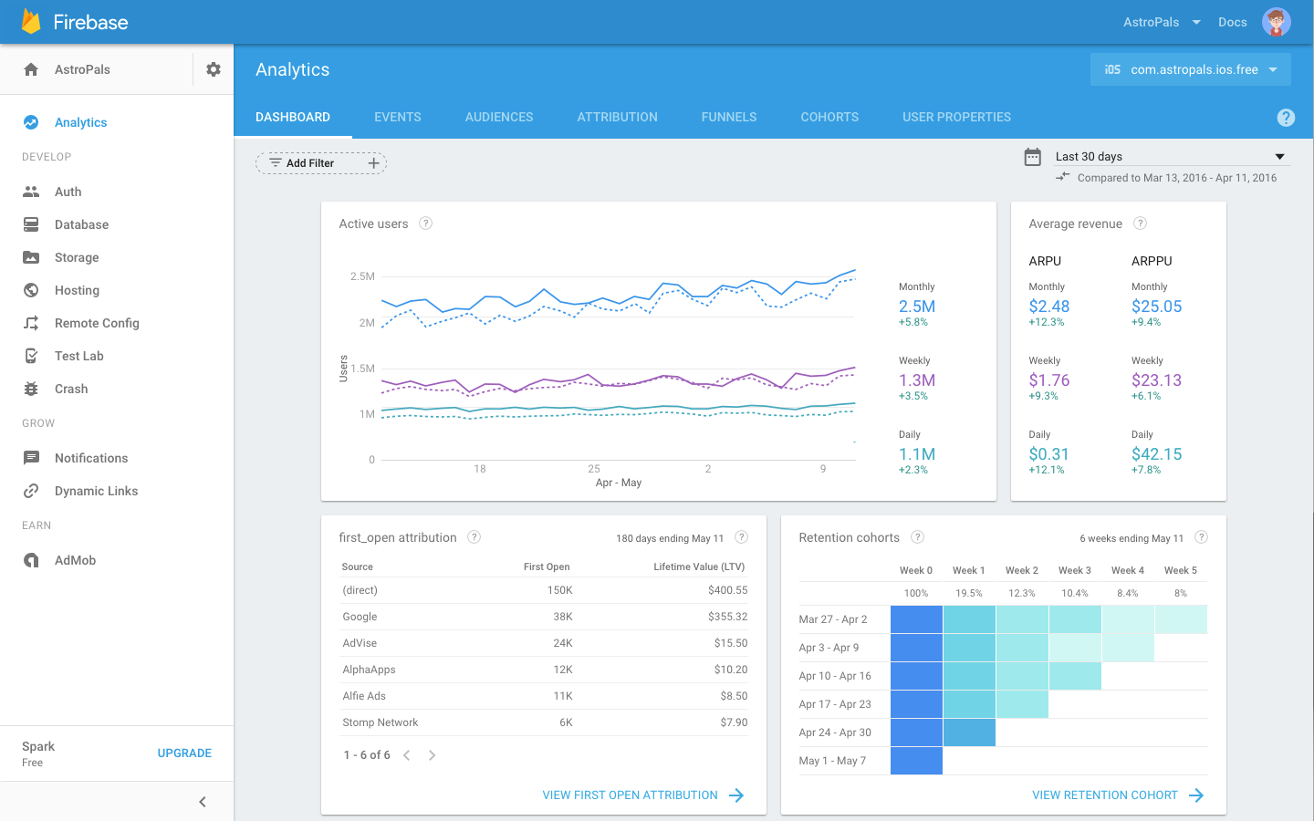
MODULE 3:
Interfacing headset with Firebase :
Using wifi which is inbuilt option in Nodemcu board we can transmit data from EEG sensor to Firebase server ,where we can store and use that data to play song s in mobile app

Slide 24

MODULE 4:
Analysing and playing music :
After getting data from Firebase base server ,the values are divided into sets and sets are named as hyper ,moderate and normal and according to those values the songs get played
24

Slide 25
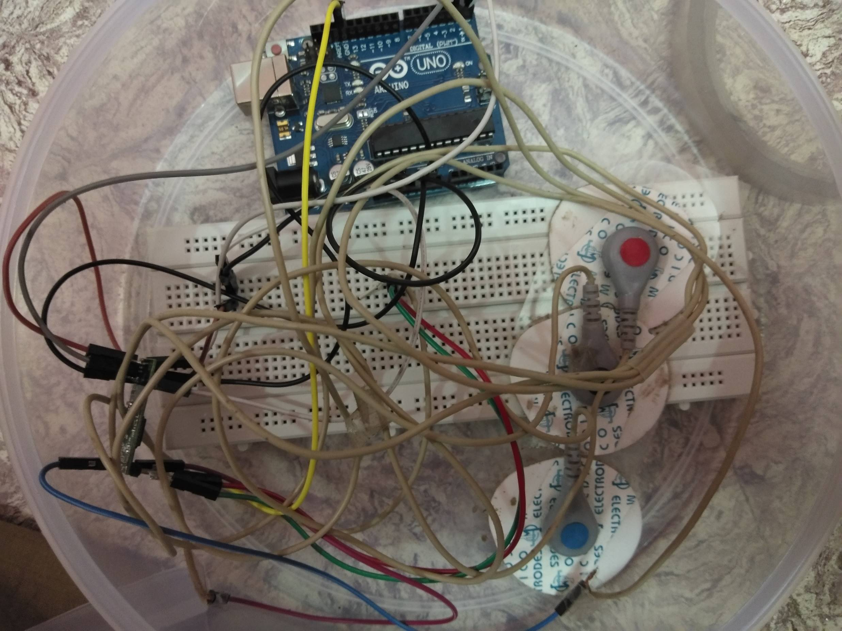
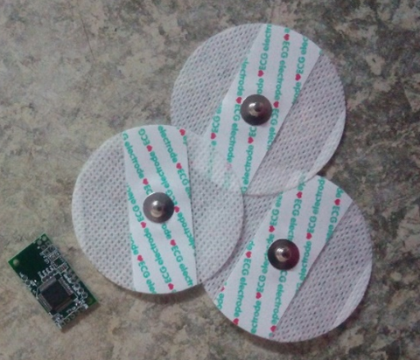
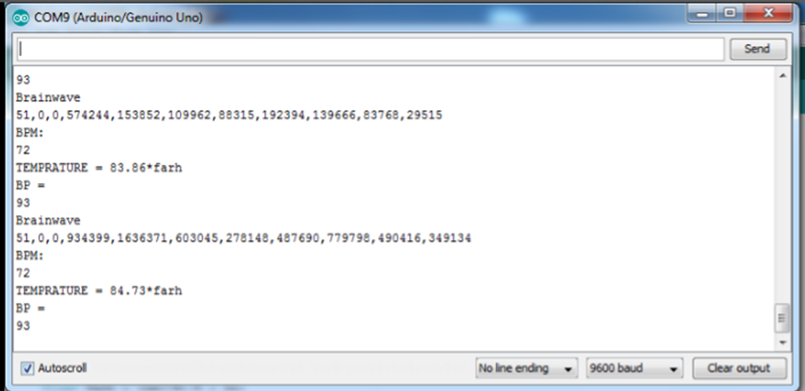
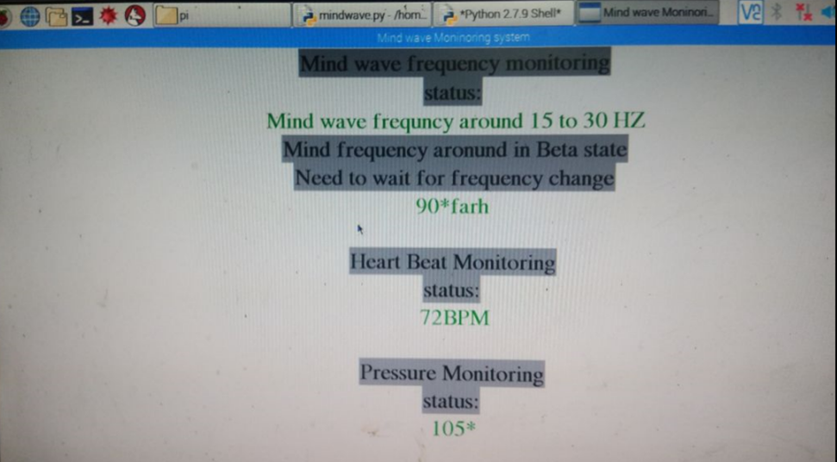
COMPLEXITY
Huge Raw EEG values to be interpreted in fraction of seconds
Non sync and Default data at certain instances
Amplification of signals are required
Decoding data formats
25

Slide 26
SAMPLE CODE :
void callback(char* topic, byte* payload, unsigned int length) {
char p[length + 1];
memcpy(p, payload, length);
p[length] = NULL;
Serial.write(payload, length);
Serial.println(topic);
}
void reconnect() {
// Loop until we're reconnected
while (!client.connected()) {
Serial.println("Attempting MQTT connection...");
}
}

Slide 27
ANDROID CODE :
?xml version="1.0" encoding="utf-8"?>
<androidx.constraintlayout.widget.ConstraintLayout xmlns:android="http://schemas.android.com/apk/res/android"
xmlns:app="http://schemas.android.com/apk/res-auto"
xmlns:tools="http://schemas.android.com/tools"
android:layout_width="match_parent"
android:layout_height="match_parent"
tools:context=".MainActivity">
android:id="@+id/textview"
android:layout_width="wrap_content"
android:layout_height="wrap_content"
android:text="Normal"
android:textColor="@android:color/black"
android:textSize="50dp"
app:layout_constraintBottom_toBottomOf="parent"
app:layout_constraintLeft_toLeftOf="parent"
app:layout_constraintRight_toRightOf="parent"
app:layout_constraintTop_toTopOf="parent" />

Slide 28
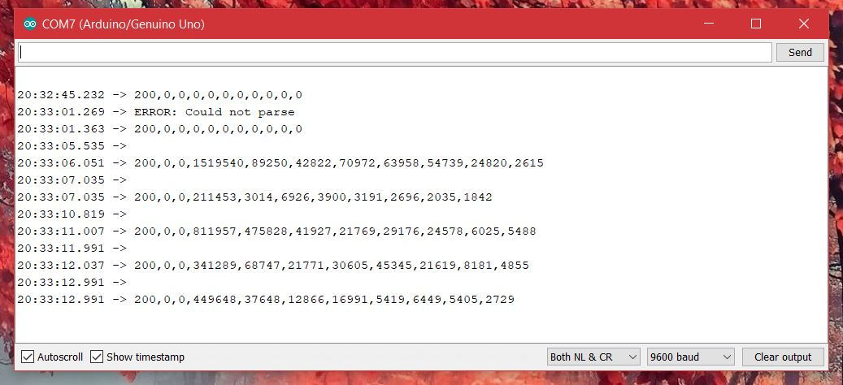
OUTPUT SNAPSHOTS

Slide 29
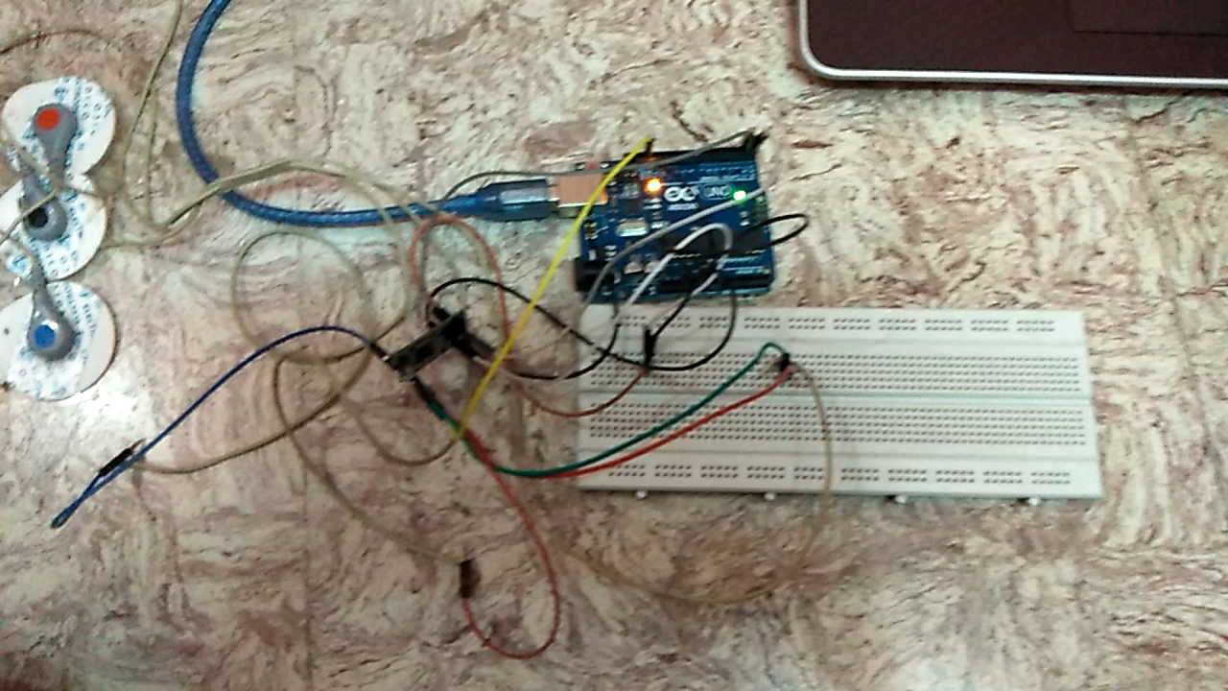
RECORDED OUTPUT

Slide 30
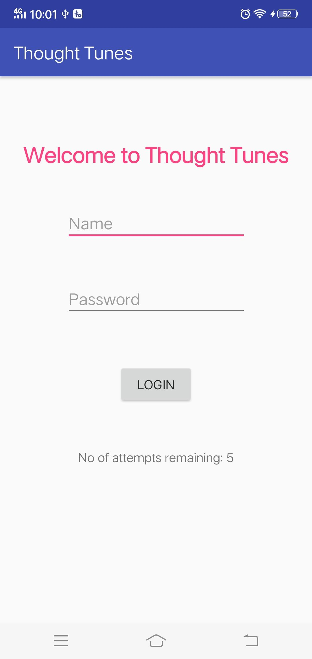
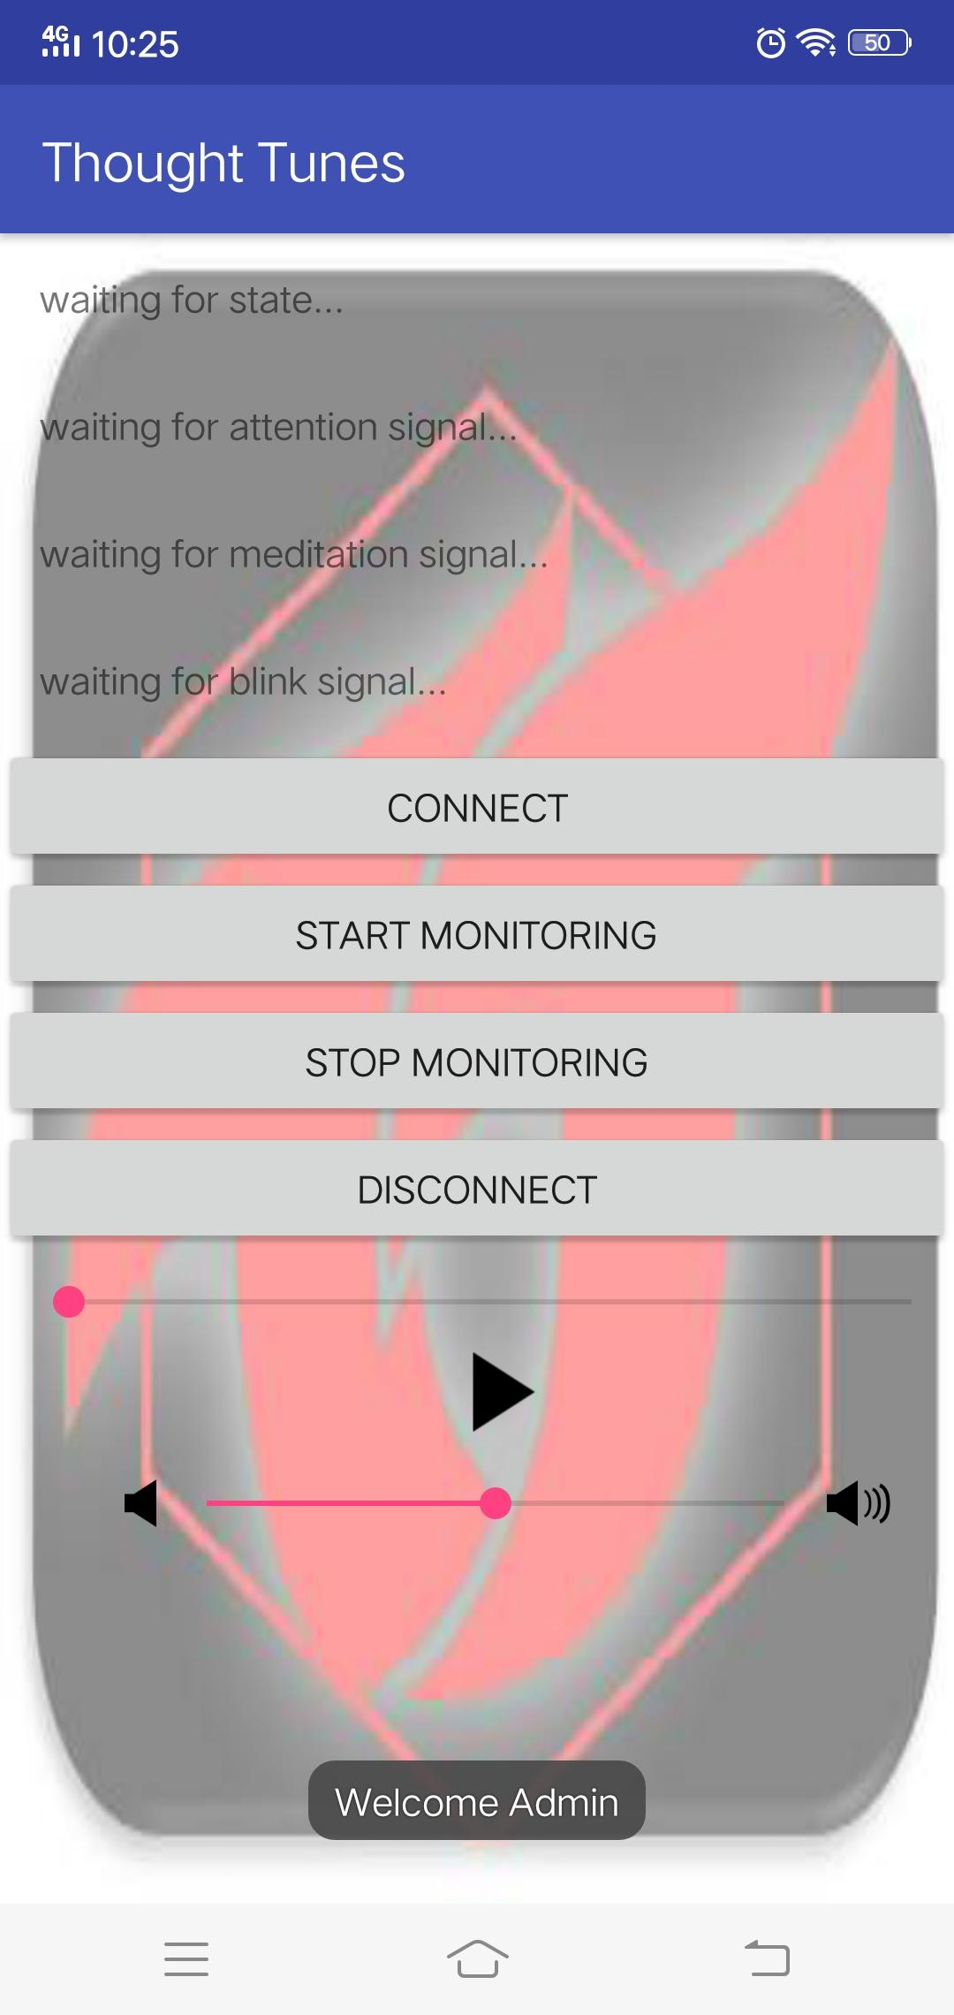
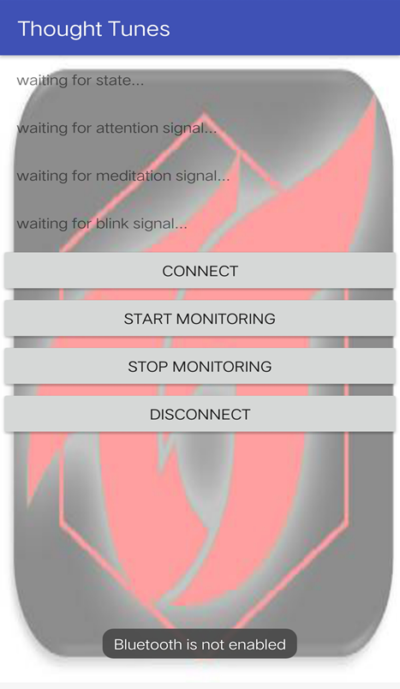
OUTPUT SNAPSHOTS

Slide 31
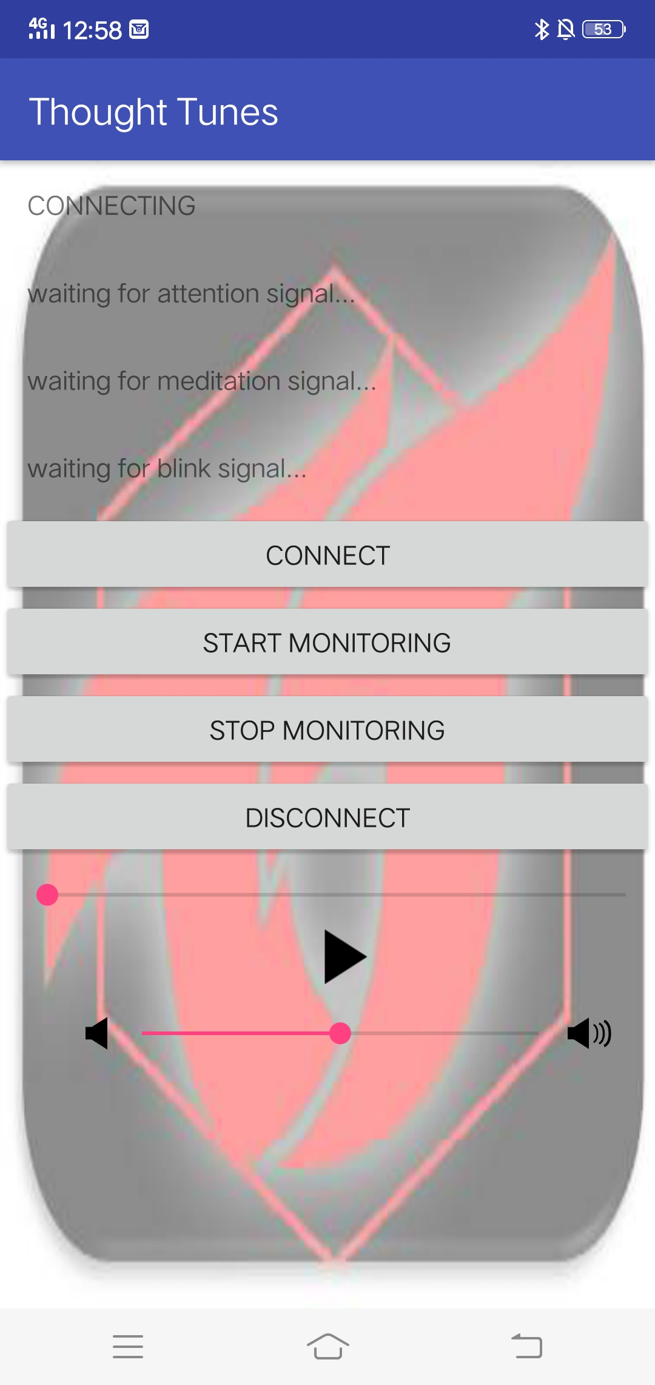


OUTPUT SNAPSHOTS

Slide 32
RECORDED OUTPUT

Slide 33
RESULT AND CONCLUSION:
In this paper, an application intervention to enhance motivated behaviour in schizophrenia affected patients (users of AITEMB).It is planned to use emotive EPOC headset to receive EEG signals. And to create an emotional database for our application. Fuzzy logic rules helps in analysing the state of emotion by classifying EEG signals and produce the resultant emotion which is further taken as an input to compute an AITEMB logic and performs the certain tasks as a final result and updated in user’s profile. In future, AITEMB application is further made to be like a social media for those users, which will avoid theindividual being isolated and develops the social behaviour when it is decelerated by the effects of schizophrenia mental disorder. The proposed system will be remedy for those mental disorders like schizophrenia which has a symptoms like delusions, paranoia, hallucinations etc... It is concluded that AITEMB will be an accurate tool to assess the emotion and perform the certain task to control over it. Future work to acquire more data from users to validate the results.

Slide 34
REFERENCE :
Haifa BLAIECH, Mohamed NEJI, Ali WALI and Adel M. ALIMI”Emotion recognition by analysis of EEG signals “Research Groups on Intelligent MachinesUniversity of Sfax, National Engineering School of Sfax (ENIS) BP1173, 3038 Sfax, Tunisia {hayfa.blaiech, mohamed.neji, ali.wali, adel.alimi}@ieee.org
Olga Sourina ·Yisi Liu ·Minh Khoa Nguyen”Real-time EEG-based emotion recognition for music therapy Received: 19 April 2011 / Accepted: 19 November 2011 © OpenInterface Association 2011
Noppadon Jatupaiboon, 1 Setha Pan-ngum, 1 and Pasin Israsena2 Real-Time EEG-Based Happiness Detection System Received 3 June 2013; Accepted 15 July 2013 Academic Editors: B.-W. Chen, S. Hsieh, and C.-H. Wu Copyright © 2013 Noppadon Jatupaiboon et al.

Slide 35
REFERENCE :
R.Scherer. What are emotions? And how can they be measured? Social Science Information, 44(4), (2005), 693-727.
E. Niedermeyer and F. L. da Silva, Electroencephalography: Basic Principles, Clinical Applications, and Related Fields, 2004.
Wikipedia,“Electroencephalography,”http://en.wikipedia.org/wiki/Electroencephalography.
Y. P. Lin, C. H. Wang, T. L. Wu, S. K. Jeng, and J. H. Chen, “Support vector machine for EEG signal classification during listening to emotional music,” in Proceedings of the 10th IEEE Workshop on Multimedia Signal Processing (MMSP '08), pp. 127–130, Cairns, Australia, October 2008.

